Slide 1


EPHS
Personal Fitness
Coach Moncus
Coach Wilson
Coach Schuyler
Coach Whitaker

Slide 2

Expectations
Face to Face
EXPECTATIONS DIGITAL LEARNING DAYS
Dress out
Participate in class…
Fitness Assessments
Fitness Mile run
COMPLETE ONLINE ACTIVIY LOG AND TURN IN BY THE DUE DATE.

Slide 3
Expectations continued for F2F or DLD.
Digital Days are not “free” days. Digital days are to work on CANVAS assignments.
Both face to face and digital assignments count towards a student’s grade.
Please check infinite campus for grades. Canvas gradebook is not an official gradebook that we use. Only infinite campus is used for official grade reporting.
Academic integrity-we are here to learn! We are here to prepare for the next grade level and to prepare for life. Students need to learn the habits of successful people, which include integrity and work ethic
We work hard designing and planning rigorous and focused curriculum, instruction, ,and assessment. We expect students to do their part and work hard!

Slide 4

What does our face to face instruction look like?
We meet in the main gym
Students will be released to dress out after attendance, and proper safety measures will be taken.
Students can expect to participate in a fitness assessments, or the mile run during class on face to face instruction days.
Bring a water bottle to refill.

Slide 5

Canvas Course information
You will access Personal Fitness class from your Course page.
Next students you will go to MODULES or the home page to access your assignments.
All details for assignment submission, due dates, teacher help, resources are embedded in the assignments you will access in Course MODULES.

Slide 6

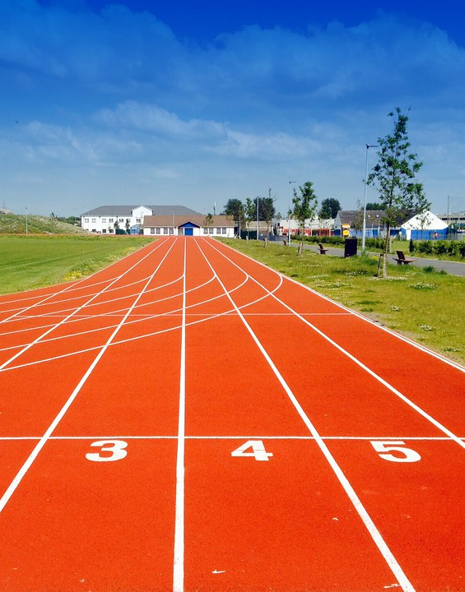
Assessments
Your mile run time will serve as your formative fitness assessments.
Your activity logs will serve as summative assessments for your participation outside of class.
We will take a final at the end of nine weeks.
This Photo by Unknown Author is licensed under CC BY

Slide 7
Tips for parents/guardians to help students to stay organized and manage their time wisely during the digital days…
Set a daily schedule for your student for digital days (when to get up, when to start working, how much time to allocate per each class on the schedule, etc.). Allow at least one hour per class.
Include breaks in the schedule as well as lunch and snack-time.
Have students use either calendar on their phone or a planner to keep up with their due dates and assignments.
Follow up with the students at the end of the day and ask them what they have completed.
Have you registered as an observer in your students Canvas course?

